Slide 1
NCAPH2 data analysis report
Yajing Hao

Slide 2
Data statistics
DataName | FileName | RawData | FilterData(QC) | CleanReads% | UniqueMappedReads | UniqueMapped% | Duplicate% | Un_Duplicates | Peaks
wm_240411_1 | WM_HCT116_Input | 57,483,269 | 56,758,640 | 98.73940885 | 54,214,258 | 95.52 | 4.91 | 51,552,338
wm_240411_3 | WM_HCT116_IgG | 23,335,358 | 22,851,426 | 97.92618566 | 17,017,959 | 74.47 | 2.67 | 16,563,579
wm_240411_7 | WM_HCT116_275A_R1 | 34,127,460 | 33,330,921 | 97.66598803 | 28,639,398 | 85.92 | 16.48 | 23,919,625 | Rep2 VS input: number = 496
wm_240411_8 | WM_HCT116_275A_R2 | 25,662,878 | 24,668,675 | 96.12590996 | 19,824,736 | 80.36 | 16.91 | 16,472,373
wm_240411_9 | WM_HCT116_275A_R3 | 53,829,847 | 52,668,859 | 97.84322627 | 45,621,045 | 86.62 | 16.93 | 37,897,402
wm_240411_2 | WM_CAPH2AID_Input | 25,157,103 | 24,923,571 | 99.07170551 | 23,354,105 | 93.70 | 4.49 | 22,305,506
wm_240411_10 | WM-CAPH2AID_275A_R1 | 22,865,893 | 22,498,270 | 98.39226485 | 20,429,893 | 90.81 | 8.58 | 18,677,008 | Fail
wm_240411_11 | WM-CAPH2AID_275A_R2 | 35,994,813 | 35,505,984 | 98.64194599 | 32,671,392 | 92.02 | 9.51 | 29,564,343
wm_240411_12 | WM-CAPH2AID_275A_R3 | 26,303,043 | 26,000,829 | 98.85103028 | 24,182,066 | 93.00 | 8.88 | 22,034,699
wm_240411_13 | WM-CAPH2IAA_275A_R1 | 6,732,191 | 6,616,220 | 98.27736617 | 5,278,217 | 79.78 | 10.35 | 4,731,922 | Fail
wm_240411_14 | WM-CAPH2IAA_275A_R2 | 26,253,885 | 25,535,241 | 97.26271369 | 16,404,091 | 64.24 | 25.01 | 12,301,428
wm_240411_15 | WM-CAPH2IAA_275A_R3 | 29,251,351 | 27,790,651 | 95.00638449 | 16,136,256 | 58.06 | 30.65 | 11,190,494
wm_240411_4 | WM_CAPH2IAA_HA_R1 | 19,557,595 | 19,312,676 | 98.7477039 | 17,936,571 | 92.87 | 8.97 | 16,327,661 | Rep2&Rep3 VS Input number=318
wm_240411_5 | WM_CAPH2IAA_HA_R2 | 14,849,525 | 14,662,324 | 98.73934688 | 13,705,713 | 93.48 | 8.26 | 12,573,621
wm_240411_6 | WM_CAPH2IAA_HA_R3 | 15,172,497 | 14,935,248 | 98.43632198 | 13,564,199 | 90.82 | 8.54 | 12,405,816

Slide 3

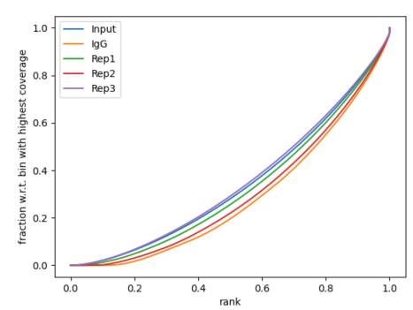
Antibody strength
HCT116_WT
Rep2 looks ok, and peak is broad peak

Slide 4

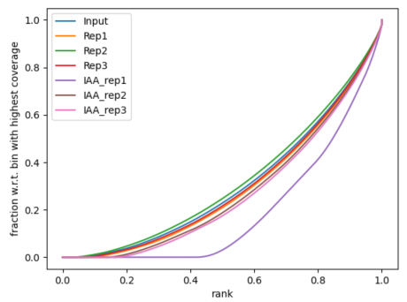
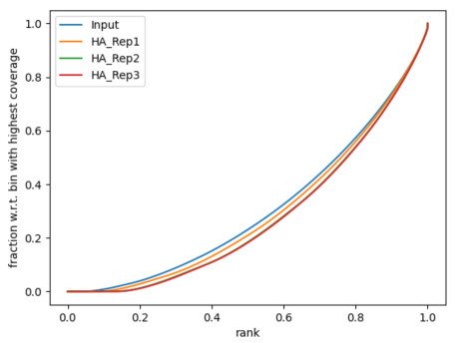
Antibody strength
HCT116_AID
Antibody failed
HCT116_AID
Antibody almost failed, but we can try Rep2 and Rep3.

Slide 5
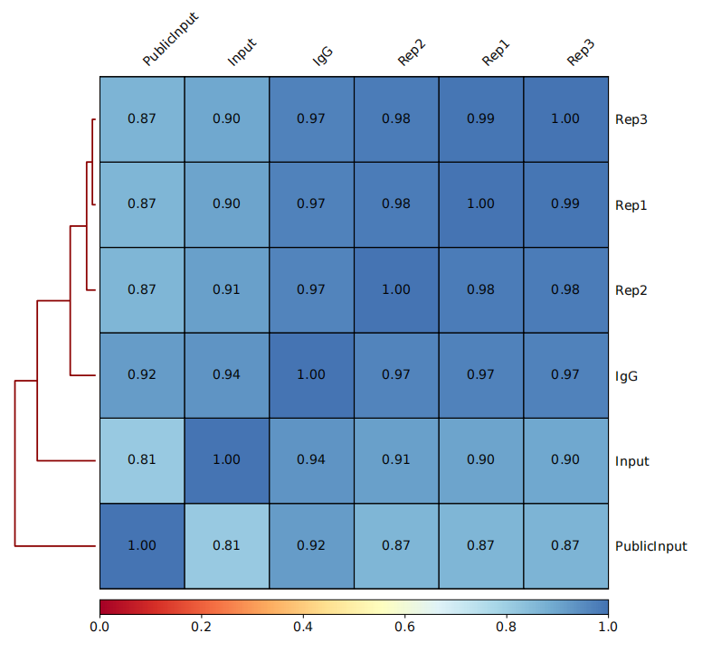
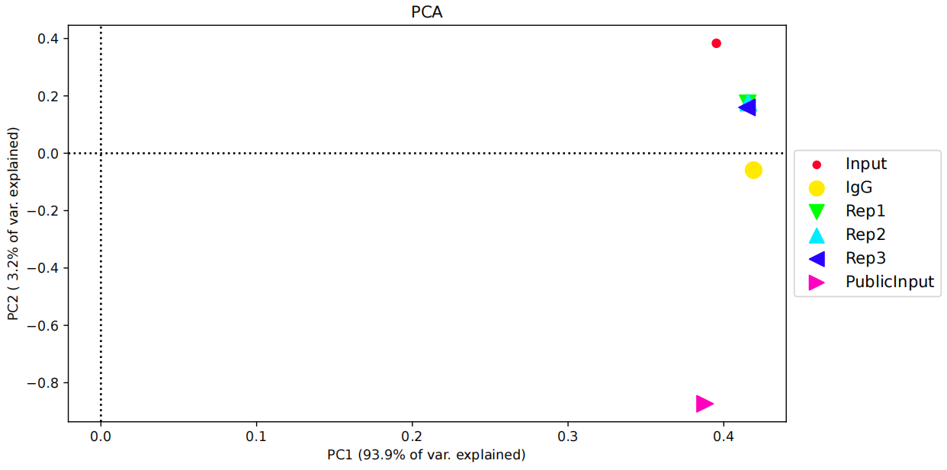

Biological correlation-HCT116_WT
The data is bad. Even though, treatment group can be separated from control group. But they show high similarity with IgG and Input files.
Batch effect: Yes. The public data is different from in-house data.

Slide 6
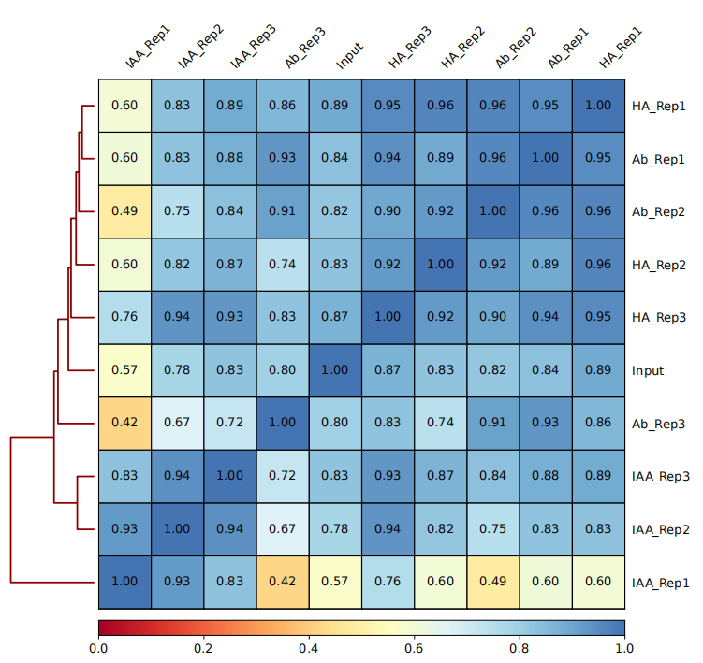
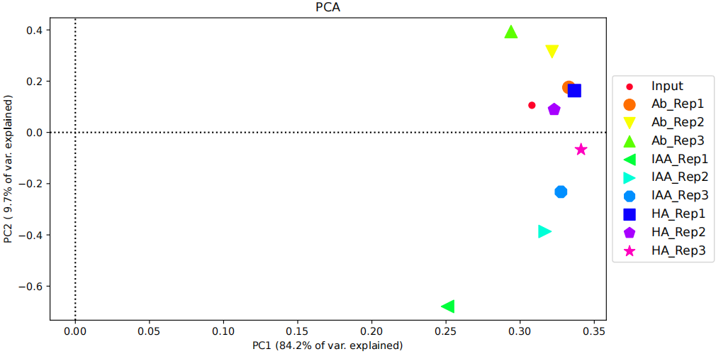

Biological correlation-HCT116_AID
The data is bad. Not grouped by treatment.

Slide 7
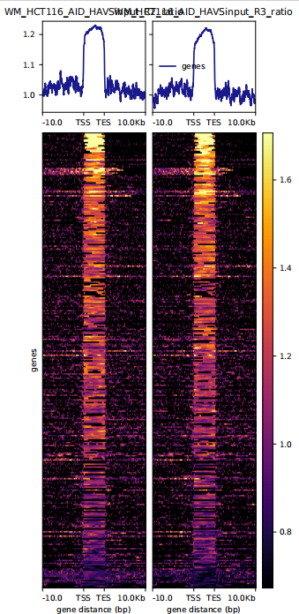
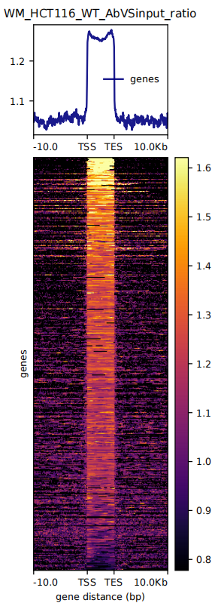

Peak quality
The peak quality looks good!

